Slide 1

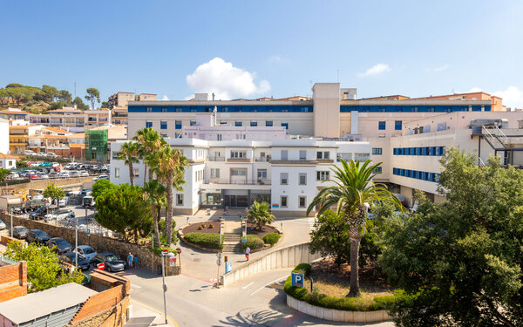
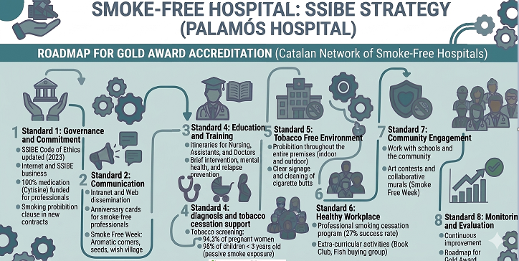
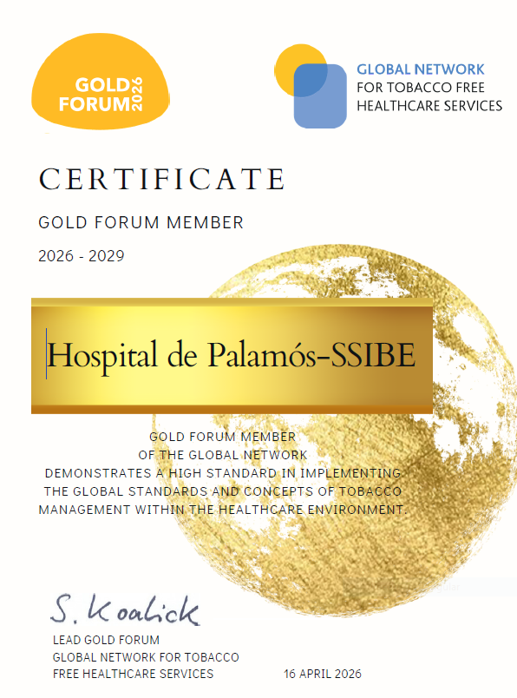
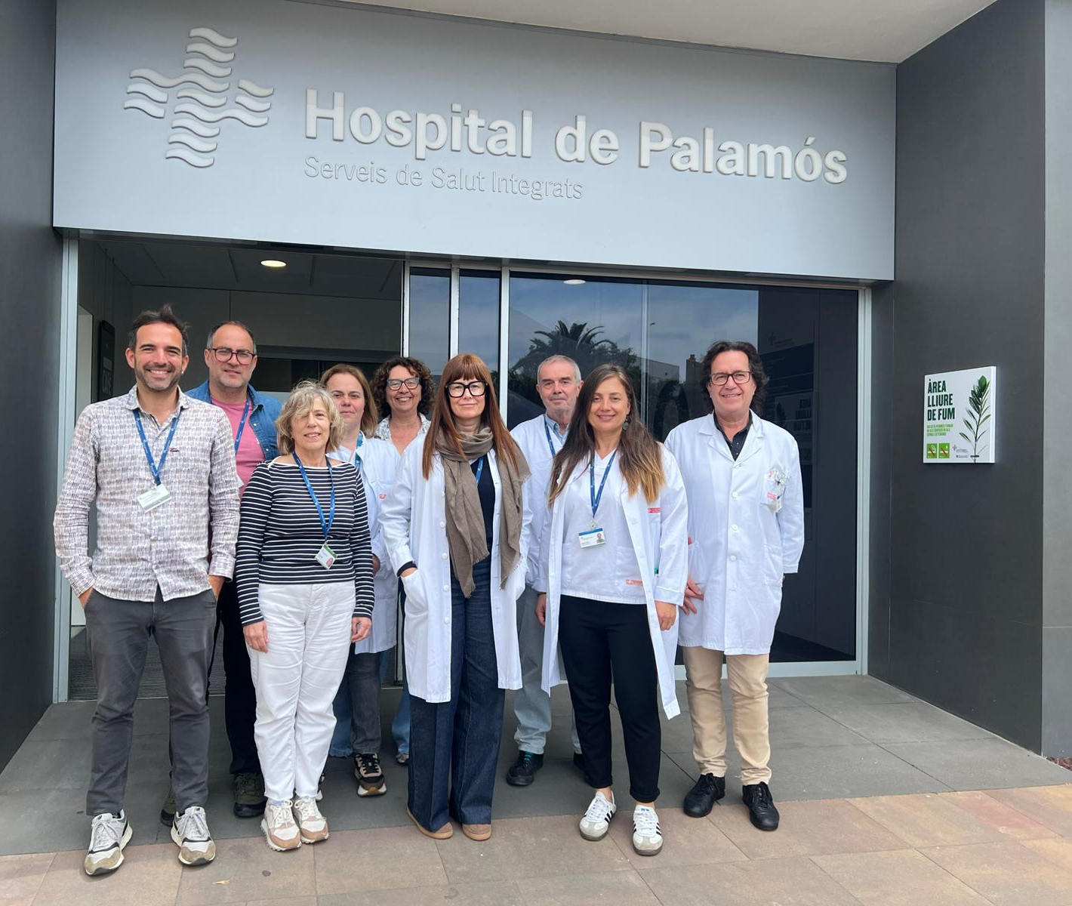
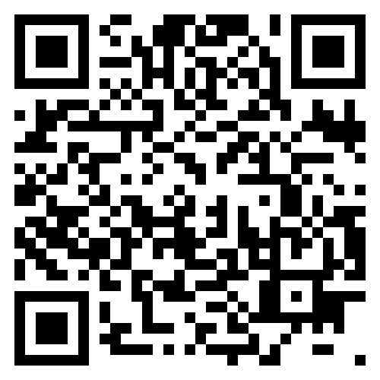
SMOKE-FREE HOSPITAL
SSIBE strategy - Palamós Hospital
Almodóvar F. Artigas G. Cama M. Domínguez G. Ibáñez S. Manonellas G. Martí I. Molina JM. Mora T. Palomeras X. Pérez E. Rodríguez MC. Toda R. Triadó A. Turró M.
Comité Hospital sense fum
Fundació Hospital de Palamós-SSIBE
CHALLENGE
Palamós Hospital-SSIBE Foundation implements a comprehensive strategy for smoke-free spaces. We have a specialised committee that has coordinated the programme since 2007, with continuous improvement and the monitoring of the corresponding annual evaluations, which has enabled us to implement a roadmap for the strategy while securing the Gold Award for our organisation.
One of our key highlights is the commitment of the Management, which has enabled us to carry out all the proposed initiatives. The provision of free medication for all professionals has driven a significant improvement. As early as 2026, we have committed to training all professionals in groups 1 and 2 (doctors and nursing staff), with the aim of acting as a catalyst for change for our population, actions that demonstrate our commitment and firm belief in this project.
ACTION/SOLUTION
RESULTS
There is always room for improvement, and we will continue working in this vein to maintain this award, which shows us that things can be achieved when you truly believe in them and have the help and support of your management.
A special mention also goes to all the members of the Committee for all the effort and work they have put in over the years.35
Let’s keep working!
More info about our strategy
Board of the Smoke-free Hospital Committee

